Slide 1
Mood of Music
Introduction to Computer Music

Slide 2
The concept of our project
First Goal
Given any song we first want to identify the mood of the music.
For example: Given the song we want to extract features of songs that will help us determine the mood of the song is happy rather than sad.
Second Goal
Based on the classifications, we use markov chain to generate a sound that can express the mood.

Slide 3
Naive Bayes Classification
To Implement our Classification we need
1. Classes and Features
2. Training data
3. Test data
4. Evaluation
Notes:
Objects with (manually) assigned classes and are assumed to be representative of a sample.

Slide 4
Our Data and Classifying Accuracy
We had 120 manually labelled dataset.
Mood Classes: Happy, Sad, Calm and Angry
Features: Tempo, R-M-S energy (A Librosa Feature)
Training data: 70% Testing data: 30%
Result Evaluation- 28.6% accurate. If we had used more data or made our class smaller ( just happy or sad) we’d have gotten better results.

Slide 5
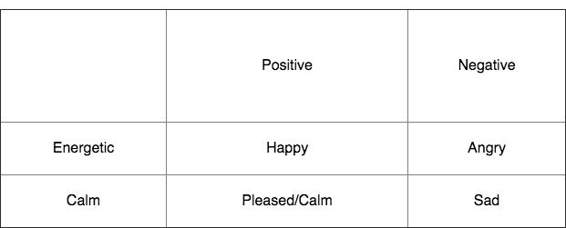
Classifying Accuracy
Sub-Labels:
We then got ~70% Accuracy for Energy Prediction and Tempo Prediction.
Cumulatively ~30% Accuracy but the baseline was lower (5%)

Slide 6
Generation - Markov Chain
C5
D5
E5
F5
Next Note
P1 | P2 | P3 | P4
P5 | P6 | P7 | P8
P9 | P10 | P11 | P12
P13 | P14 | P15 | P16
C5
P1 + P2 + P3 + P4 = 1
Same with other rows
D5
Current Note
E5
F5

Slide 7
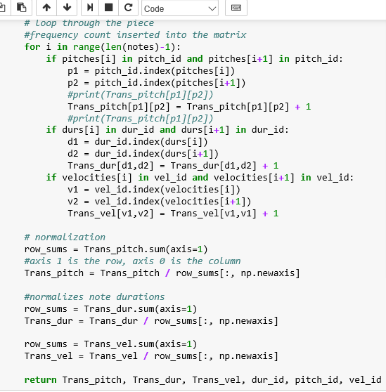
Slight Changes:
Taking velocity into account
Storing note durations without rounding

Slide 8
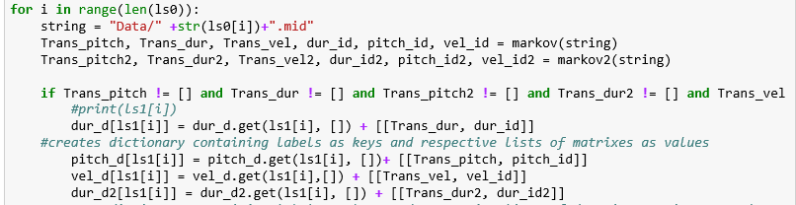
Collecting The Data

Slide 9
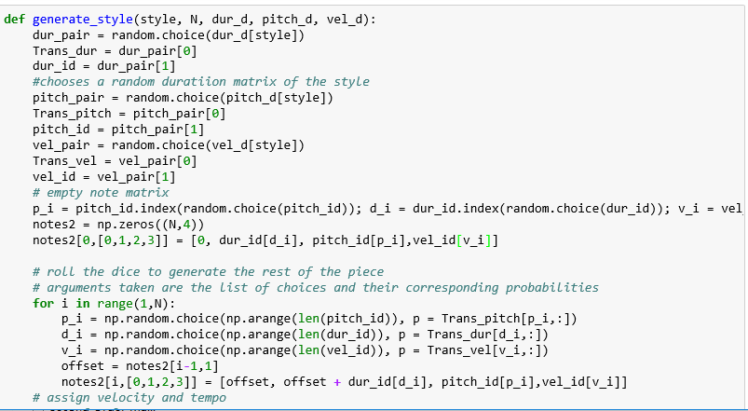
Generation
Random combination of pitch, duration, velocity under one style label
May not make sense musically…
But it’s still interesting!

Slide 10
Generation - Markov Chain
P( Xn | Xn-1 )
P( Xn | Xn-1, Xn-2 )
First Order
Second Order

Slide 11

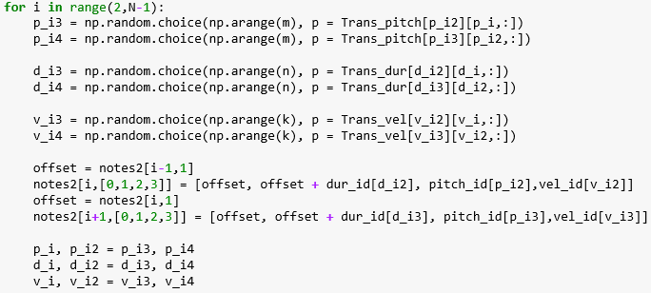
P( Xn | Xn-1, Xn-2 )
Changes
Second Order

Slide 12
Demo : All sounds were created by the computer!

Slide 13
Thank You

